Slide 1
GOVERNORS STATE UNIVERSITY CPSC-8845-01_22SU: Advanced Database Concepts PROJECT MOVIE TICKET RESERVATION SYSTEM
Student Name: Sanjay Boga
Student ID: 1241032
Instructor: Yili Tseng

Slide 2
Introduction
During last era, motion pictures became very widely known. It demonstrates our cultures, and innumerable movies are launched every year by large international companies such as Netflix, Amazon, HBO, and others. Earlier, the one and only way to watch a film was in a "cinema," and humans became obsessed to even bluescreen. Theses days, thanks to the world of technological advancements, it becomes much simpler to watch a film.
Having followed the tremendous feedback from moviegoers over the last few decades, a new industry, movie ticket booking, has emerged as a subset of the same industry. With the expansion of cinema across the globe, distributing and purchasing tickets has become one of the most difficult tasks. To address this issue, a movie ticket reservation system has been implemented. This allows moviegoers to purchase movie tickets in a matter of minutes from anywhere in the world. The objective of movie ticket reservation system is provide moviegoers with a service that allows them to reserve seats in movie theaters anywhere and at any moment. Movie information is publicly available. The customer can quickly learn about the new cinema and then decide.
It is a mechanism that is accessible through the internet. Moviegoers can purchase tickets online and cancel their seats at a later date. To improve the reimbursement feature, all consumers must sign up to become a member before purchasing a ticket.

Slide 3
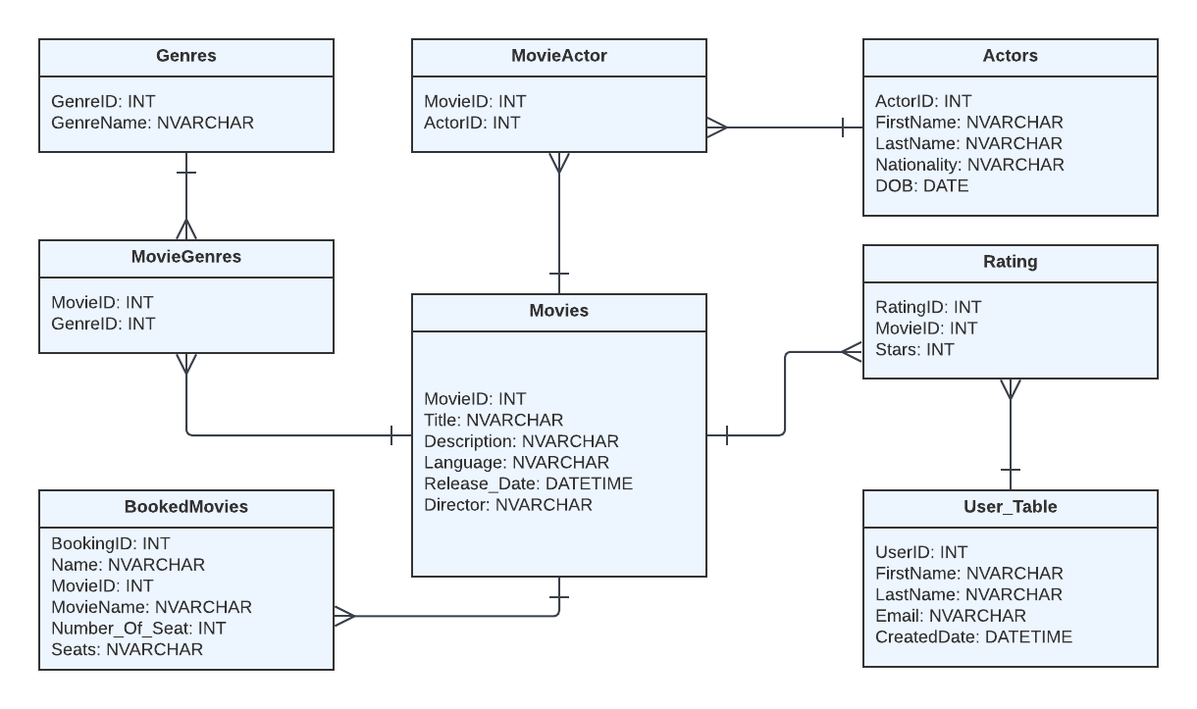
UML Diagram

Slide 4
Table Name | Columns | Description
Genres | GenreID , GenreName | This table uses to store information related to category of movies such as action, horror or crime
Movies | MovieID, Title, Description, Language, ReleaseDate, Director | Movies table stores the basic but essential information related to specific movie such as movie name, who is the director, when did it got released and many more.
Actor | ActorID, FirstName, LastName, Nationality, DOB | This table stores the actors details who has worked as a primary lead actor in the respective movie which is linked by another table called MovieActor.
Ratings | RatingID, MovieID, Stars | This table keep holds of number of stars/rating received by IMDB or users.
MovieGenres | MovieID, GenreID | This schema shows the link between two table i.e. movie and genres and link both of them using foreign key to fetch the category of gerne movie belongs to.
MovieActor | MovieID, ActorID | MovieActor is a relational table between actor and movie which link up using foreign key to fetch the lead actor working in respective films.
User | UserID, FirstName, LastName, Email, Created_Date | This is the user details table which is specific to our application. Talkies allows the user to first register in our portal and then allow to book the movie tickets.
BookedMovies | BookingID, Name, MovieID, MovieName, Number_of_Seat, Seats | This table is used to stored the booking details when user book any movies.

Slide 5
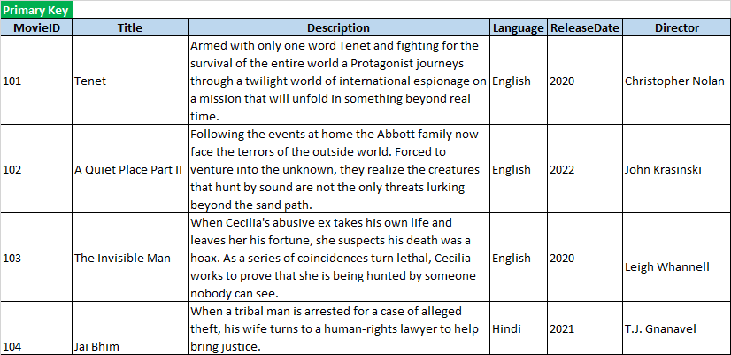
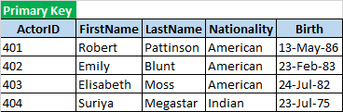
Tables
Table 1: Movies
Table 2: Actors

Slide 6
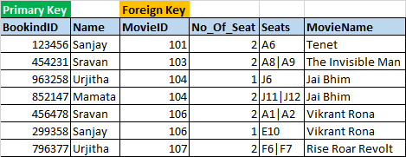
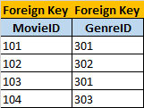
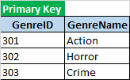
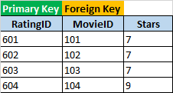
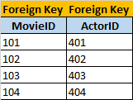

Table 3: BookedMovies
Table 5: MoviesGenres
Table 4: Genres
Table 6: Rating
Table 7: User_Table
Table 8: MovieActor

Slide 7
Implementation of key constraint, entity integrity constraint, and referential integrity:
Table Name | Primary Key | Foreign Key | Check Constrains | Not Null
ACTORS | ACTORID |  | NATIONALITY IN ('American', 'Indian') | ACTORID FIRSTNAME LASTNAME NATIONALITY
MOVIEGENRES |  | MOVIEID GENREID
USER_TABLE | USERID |  |  | USERID FIRSTNAME EMAIL
BOOKEDMOVIES | BOOKINGID | MOVIEID
GENRES | GENREID |  | GENRENAME IN ('Action', 'Horror', 'Crime') | GENREID GENRENAME
MOVIEACTOR |  | MOVIEID ACTORID
MOVIES | MOVIEID |  |  | MOVIEID TITLE LANGUAGE RELEASE_DATE DIRECTOR
RATING | RATINGID | MOVIEID | STARS > 1 | RATINGID STARS

Slide 8
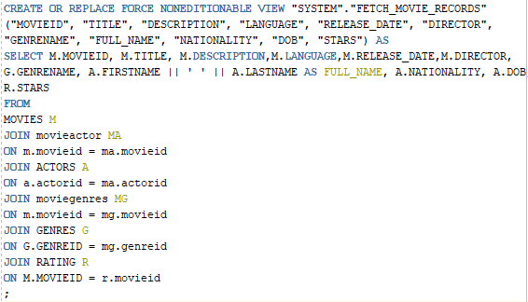
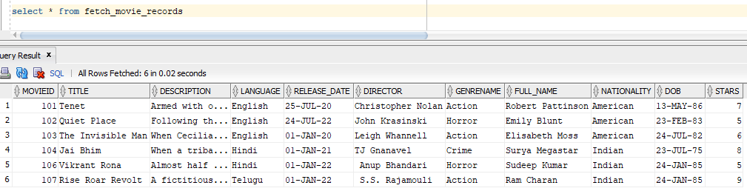
Views

Slide 9
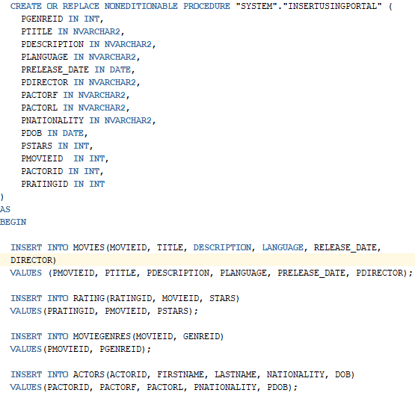
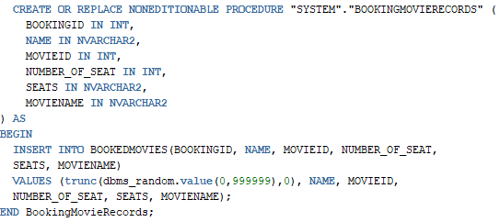
Stored Procedure

Slide 10
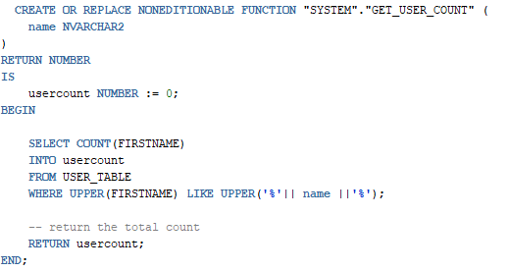
Functions

Slide 11
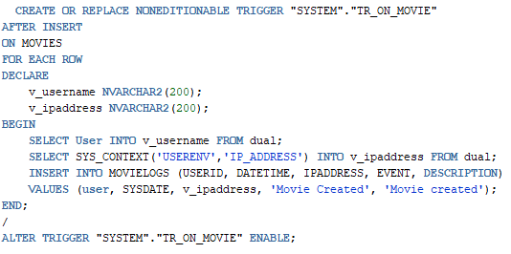
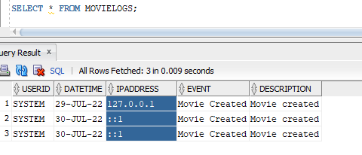
Trigger

Slide 12
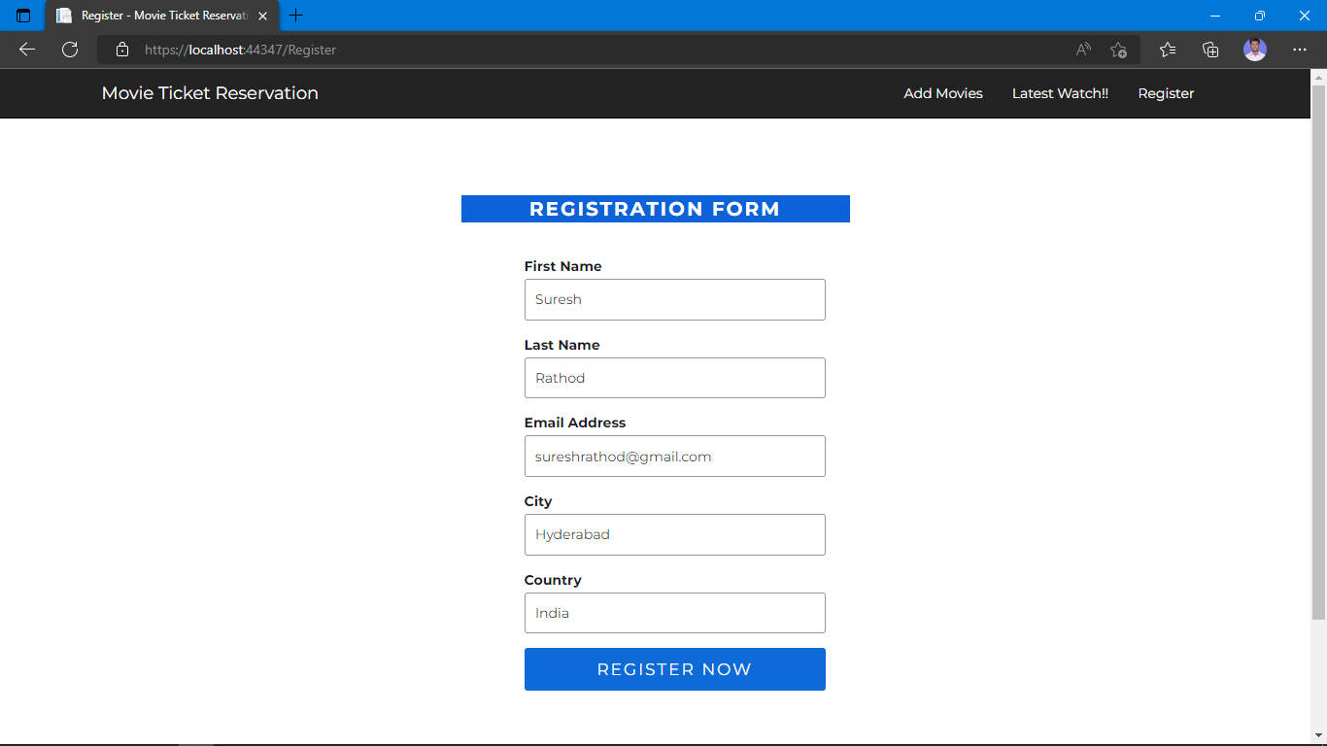
Web Application Using ASP .Net C#:
Module 1 – Register

Slide 13
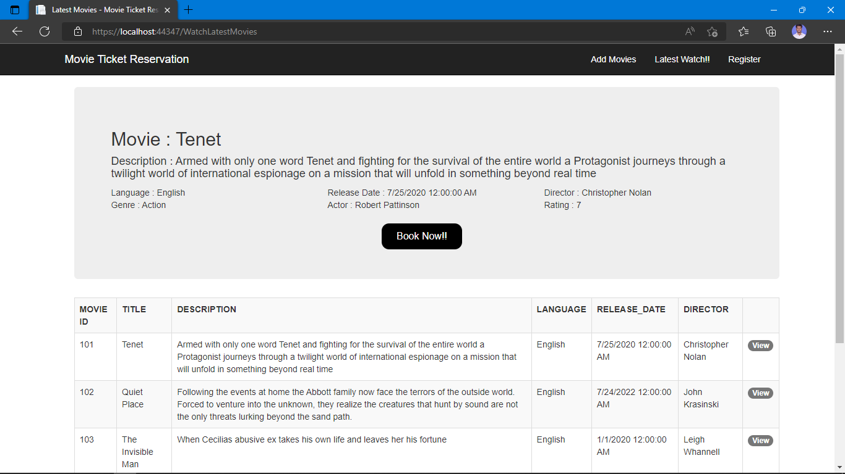
Module 2 – Latest Movies

Slide 14
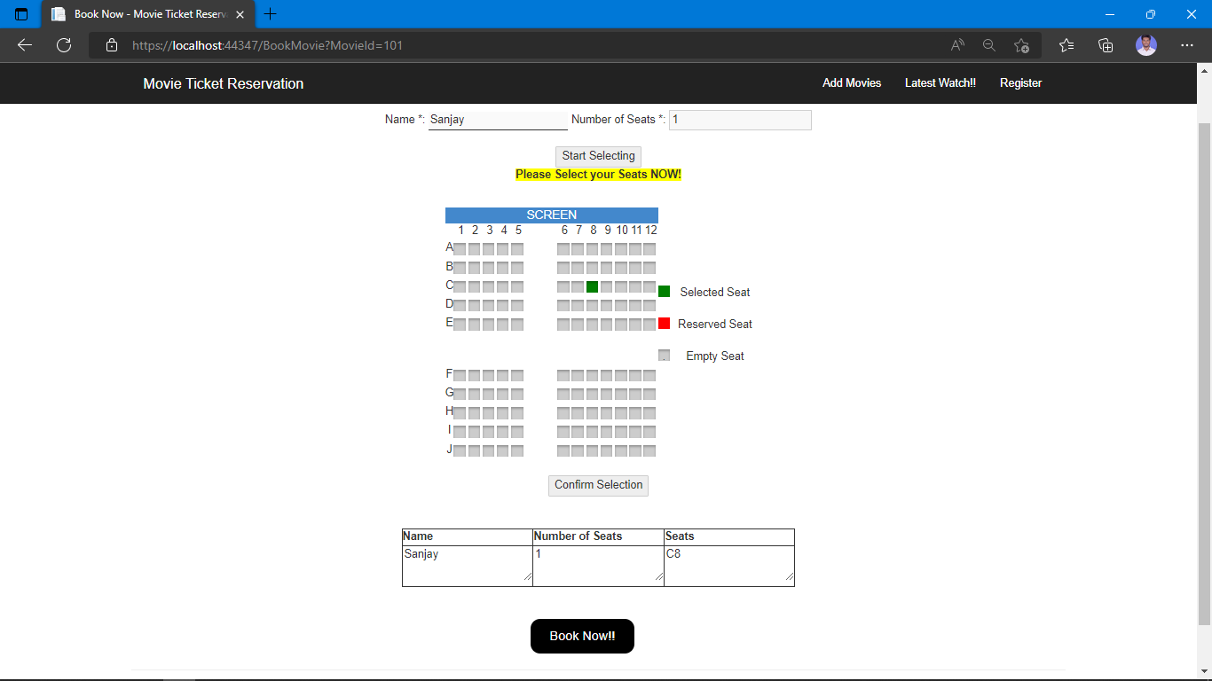
Module 3 – Book Movies

Slide 15
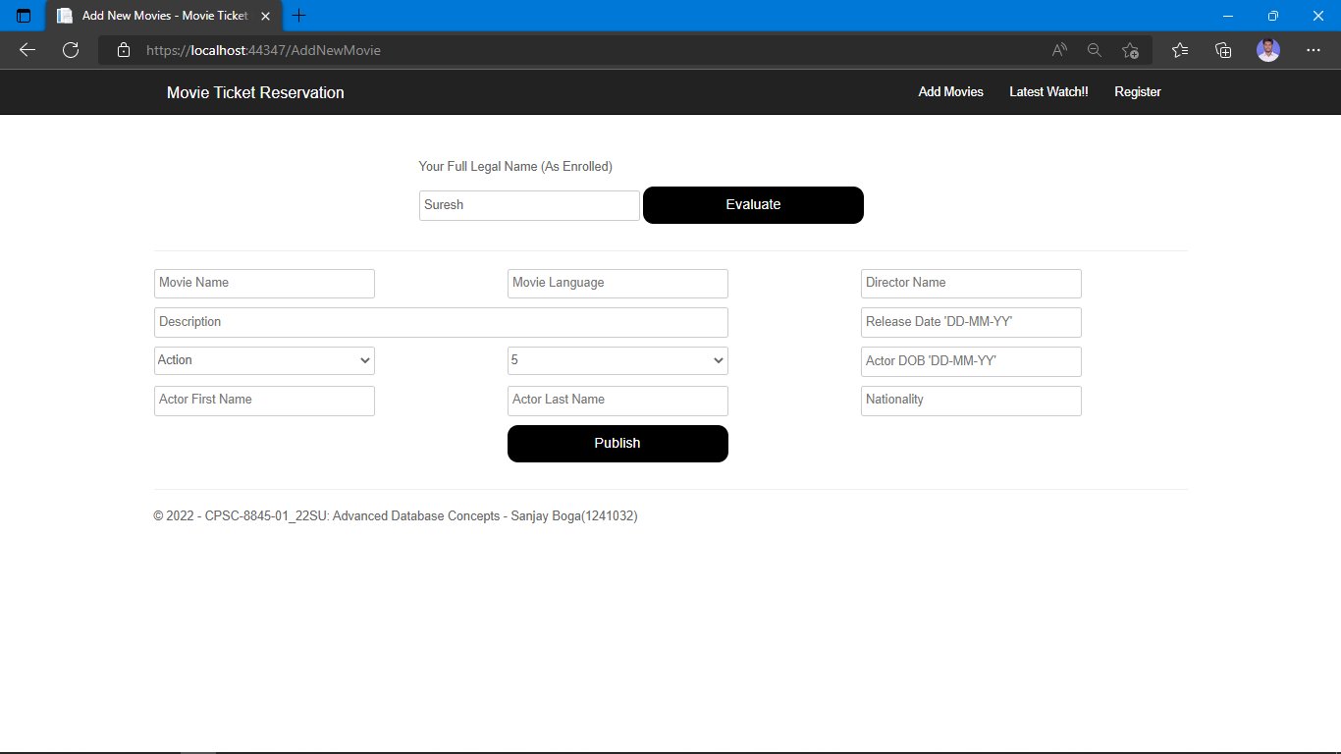
Module 4 – Add New Movies

Slide 16
Thank You

